Slide 1

LatentView Proposal – Next Priorities for Revlon
Nov 2018

Slide 2
Analytics roadmap

Slide 3
Analytics roadmap
Data is core to analytics framework
4
Artificial Intelligence
3
Advanced Analytics
2
Real Time Reporting
Trend Identification
Virtual Personal Shopping - Augmented Reality
Image search in Platform
Forecasting
Marketing mix modeling
Targeting & personalization
1
Traditional BI*
Chatbot & voice based reporting
Near Real time metrics monitoring
Customized Visualizations
Static reporting
Integrating reporting tools with other technologies
Auto Triggers, alerts
Tableau, PowerBI,
BI Applications
React, Angular
Real Time Data Pipelines
Spark, H2O
Big data platforms
Neural networks, Tensorflow, Keras, PyTorch
Internal Data+ External Data

Slide 4



Data as a service
Show some research which says CPG companies are moving to cloud and using data as a service, instead of worrying about infrastructure needs.
In house central repository vs data in the cloud.
or Advantages of data in the cloud
Key questions that need to be addressed
1
2
3
How to acquire data?
How to create a unified data view?
How to enable consumption?
Identify the correct tools to combine data from different sources based on the data type
Integrating various forms of data into centralized data lake using on-premise & cloud based technologies
Enable support for Visualization or Machine learning techniques like Forecasting, clustering and other advance analytics

Slide 5










Integrating large volume of data from multiple sources
How to acquire data?
How to create a unified data view?
How to enable consumption?
The objective would be to show logical architecture in simple terms where we are showing migration of historic data to AWS (cloud) + creating repository for Integrating data from current sources like SAP for supply chain/manufacturing, Sales data from Nielsen & NPD, social data etc.
Structured Data
External / Internal
Customer Data
Web Data
Data Integration
METRIC & EXCEPTION
REPORTS
Marketing Data
Structured
Payment Data
Data store pipelines enables metric & exception reporting
App Data
INTERACTIVE VISUALIZATON
Data Lake
Product Information
API endpoints enabling integration with
other systems
OPERATIONAL
Unstructured Data
External / Internal
Voice Data
Unstructured
ML / AI Workbench for
Prediction & Insights
Chat Data
ADVANCED
ANALYTICS
Email Data
Biometric Data
Social Data
Other data sources

Slide 6
Traditional BI & reporting
Power BI demo, followed by demo of chatbot and snap

Slide 7
Real time reporting

Slide 8








Meet IRA – Amazon Lex Powered Innovation Radar Assistant!
Ease of Use
IRA can be a faster alternative for Innovation Radar to search for answers to questions around consumer feedback across Whirlpool and competitor brands via simple conversations
Flexibility & Scalability
IRA also provides output in the form of charts and scans millions of records to deliver the right insight to the right person
BENEFITS OF
To access
test version of IRA
Personalization & Deep Dives
IRA can provide both high-level as well as granular insights based on the business query
AI driven UI
IRA’s user interface (UI), is driven by artificial intelligence (AI) incorporating Amazon Lex
Notes:
Anonymized Link: http://18.215.103.212:5000/
Un-anonymized Link: http://ec2-52-200-210-195.compute-1.amazonaws.com:5000/,

Slide 9
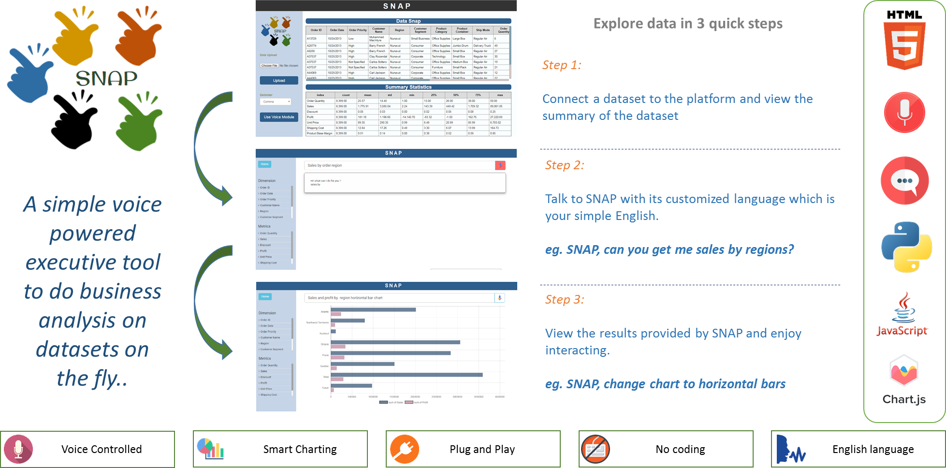
SNAP – Voice based platform
Demo: SNAP
Notes:
Link: https://52.44.241.227:8888/
Use the default, pre-filled username and password to login
---
Sample text based questions are:
what is the sum of Total Price by seller
what is the average Unit Price by customer
what is the maximum Total price by customer
what is the sum of total price by date

Slide 10
Forecasting & Spend Optimization

Slide 11
Forecasting
Forecasting refers to the process of predicting the future demand for the firm’s product. In other words, forecasting is comprised of a series of steps that involves the anticipation of demand for a product in future under both controllable and non-controllable factors.
Steps in Forecasting
Specifying the Objective
Determining the Time Perspective
Choice of method for Forecasting
Collection of Data and Data Adjustment
Estimation and Interpretation of Results
Period for which forecast is required:
Application of Forecasting:
Manufacturing
Retail
Sales
Website Traffic
Weather Forecast
Short Term Forecast | Long Term Forecast
Daily/Weekly/Monthly Horizon | Single/Multi-Year Horizon
SKU/Product Level | Aggregated Level
Inexpensive and quick | Expensive and Time Consuming
For Short Term Planning | Deals with comprehensive Issues
Usually More Accurate | Less Accurate

Slide 12
CAT Web Tool
Demo: CAT Web Tool
User ID: demo@latentview.com / Password: catdemo
Notes:
CAT Web Tool
Link: http://cattool.azurewebsites.net/
User ID: demo@latentview.com / Password: catdemo

Slide 13
Spend optimization: Pillars of marketing mix platform
Ability to have precise ROI measurements at levels (market, media channel) conducive for decision making
Granularity
Seasonality
Attribution
Optimization
1. Precise
Market Mix Analysis
Scenario Testing
Custom Fit Solution
Models
Data
Ability to handle dynamic business situations for competitive advantage
2. Self Service
3. Scalable
Ability to handle increasing data volume, type and more sophisticated algorithms

Slide 14
Targeting & Personalization

Slide 15
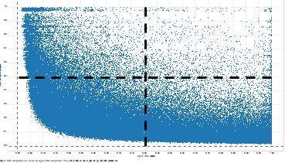
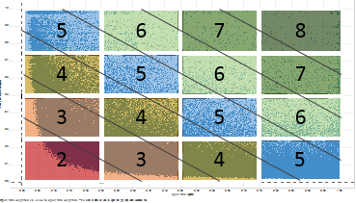
Dynamic Capacity Segmentation
Business Objective: To increase the response rate of weekly promotional email campaigns, in order to improve customer engagement
Phase I - Member Capacity Segmentation
Phase II – Content Optimization
Objective:
Modify the existing capacity segmentation rule (5x7) to further improve response rates
Objective:
Create a customer propensity score of open rate for each product based on past engagement behavior & other significant variables
Solution:
Analyze open rate vs. click to open rate for all members in-order to identify segments based on natural breaks in the plot
Segment members based on the plot. Provide more granularity in the segmentation by increasing the number of capacity buckets.
Solution:
Build and deploy a single propensity model that captures the engagement of the customer with client’s/affiliated products.
Understand the relationship of different significant variables that affect a customers tendency towards opening a mail, such as, while new products are released or new customers are signed up.
Existing Rule:
Proposed Rule:
Model output wireframe
 |  |  | Propensity to Open for each product
Customer_ID | Capacity | Test/Control | Product 1 | Product 2 | Product 3 | Product 4 | Product 5 | Product 6 | Product 7 | Product 8
AA000965 | 5 | Control | 0.35 | 0.41 | 0.97 | 0.98 | 0.69 | 0.89 | 0.25 | 0.98
AA002433 | 5 | Control | 0.84 | 0.60 | 0.49 | 0.16 | 0.27 | 0.44 | 0.22 | 0.80
AA002946 | 8 | Test | 0.66 | 0.06 | 0.70 | 0.20 | 0.98 | 0.91 | 0.59 | 0.13
AA004728 | 4 | Test | 0.17 | 0.18 | 0.55 | 0.44 | 0.30 | 0.61 | 0.51 | 0.19
AA005717 | 7 | Test | 0.14 | 0.03 | 0.95 | 0.03 | 0.52 | 0.77 | 0.06 | 0.59
AA012994 | 6 | Test | 0.35 | 0.62 | 0.45 | 0.87 | 0.62 | 0.30 | 0.40 | 0.85
Key Findings:
Approximately 1% of the customers currently fall in the top right box which is the optimal quadrant for customer engagement (Plotting click to open rates vs open rate)
59% of existing users received 4 or fewer emails per week over the past year and 21% received 2 or fewer
Capacity reduction affecting generals more than premiers members
Benefits:
Overall improvement in engagement
Reduction in un-subscriptions

Slide 16
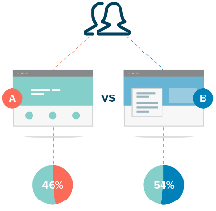



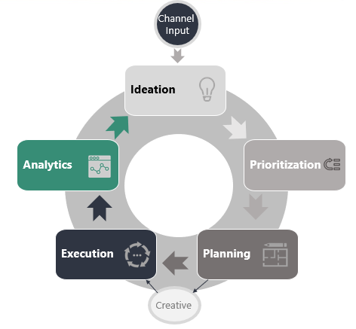
Personalization on the web using A/B Testing
A/B testing is a statistical method for improving the performance of your experiment and learning more about our audience through controlled experiments
Benefits
Implement changes immediately to get instant ROI
Implement changes immediately to get instant ROI
Discover your customers’ mindset
Translate learnings into initiatives
Drive more Revenue, Conversions and Engagement with our audience while making decisions based on data
A/B Testing
Lifecycle
Why prefer statistical method over gut based decision?
In A/B experiments, visitors are shown two different versions of an experience, and their engagement with each is measured for its improvement to accertain that the improvement is statistically significant and not just by chance

Slide 17
Thank You

Slide 18
Access management & decentralization of data platform
Usage reporting
ETL management
Moving data from existing data sources to foundry
Training
Custom build UI/apps for reporting
New features development
Framework for modeling using existing technologies like datarobot, H2O etc.
Driving adoption
Data Migration
Monitoring & Maintenance
Reporting/Apps development
Modeling
Adoption
1
2
3
4
5

Slide 19


Integrating large volume of data from multiple sources
Typical challenges during data migration…
How do we help in migrating the data?
1
2
3
4
5
6
7
Premigration planning: Exploring the source systems, multiple data models.
Project initiation: Briefing key stakeholders and project scoping
Data assessment: Data profiling, evaluating the quality of the data and its inconsistencies, challenges
Solution designing: Defining technical architecture, process on how to transition to new system
Build & test: Coding the migration logic and test on the sandbox environment
Execute & validate: Running the migration and validating the completeness of data
Production & Monitoring: Decommissioning the old system, going live with new system and monitor the data quality regularly
Poor knowledge of source data
Siloed systems, lack of data governance
Lack of integrated processes
Difficulty in validating the data specification
Late evaluation of final results during testing stage
Lack of collaboration, wrong assumptions/understanding
Business Benefits
Legacy to cloud migration – To improve efficiency, performance and scalability of application.
To adapt new changes in terms of technology, market practice, operational efficiency, regulatory requirement results in better customer service.

